Slide 1
Applying Textures

Slide 2
06 Laboratory Exercise 1
Objectives
At the end of laboratory exercise the students should be able to:
Draw a square using GL_TRIANGLES
Duplicate objects using glPushMatrix and glPopMatrix statements.
Create a cube using glRotatef from the duplicated objects.
Apply texture to the cube object.

Slide 3
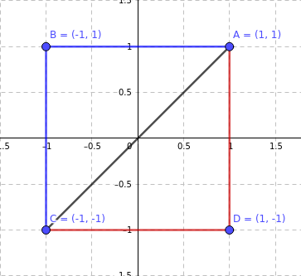
Plotting the Points
A = (1,1,1) C = (-1,-1,1)
B = (-1,1,1) D = (1,-1,1)

Slide 4
